Slide 1
Working with the VA
Forging an alliance between TU’s VSP & Veterans Affairs
Dustin Alger M.S., CTRS
Boise, ID VAMC

Slide 2
What is the VA?
The Department of Veterans Affairs is comprised of 3 separate offices:
VBA
NCA
VHA
Notes:
VBA: Veterans Benefits Administration
NCA: National Cemetery Administration
VHA: Veterans Health Administration

Slide 3
Veterans Benefits Administration (VBA)
File Claim
Review Claim
Award Rating
Notes:
The VBA is responsible for administering the Departments programs that provide financial and other forms of assistance to Veterans, their dependents, and survivors.
The VBA is responsible for working and determining a Vets individual claim, related to their service regarding compensation and award of service related conditions and diagnosis.
Once a Vet has received their individual award of service related disability, they are entitled to enroll in the Veterans Health Administration for healthcare and other services to include mental health, caregiver support, compensated work therapy, and other programs.

Slide 4
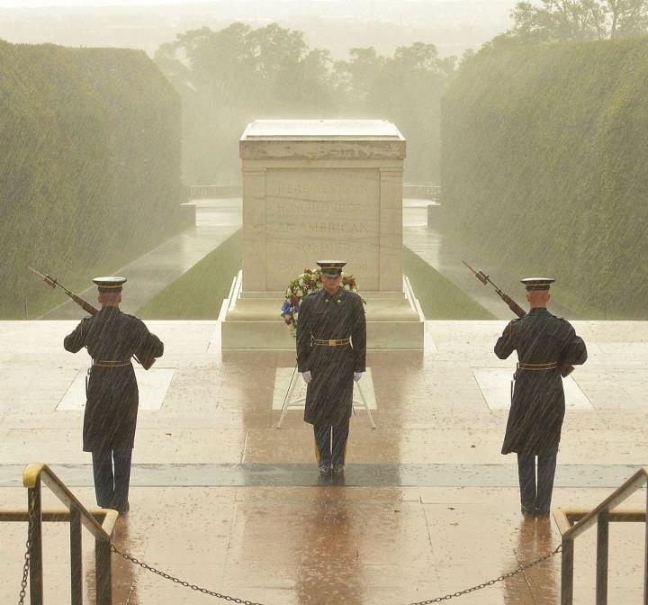
National Cemetery Administration
Notes:
The NCA oversees and operates 135 national cemeteries and 33 soldiers’ lots in 40 states and Puerto Rico. More than 4 million Americans, including Veterans of every war and conflict, are buried in national cemeteries.
Burial in a VA national cemetery is open to all members of the armed forces and Veterans who have met minimum active duty service requirements, as applicable, and were discharged under conditions other than dishonorable.
In the pics: Arlington, Tomb of the Unknown Soldier

Slide 5
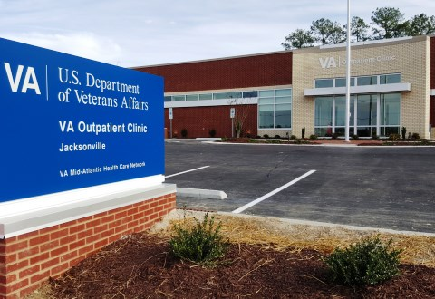
Veterans Health Administration (VHA)
Notes:
The VHA is the largest integrated health care system in the United States, providing care at 1,233 health care facilities, including 168 VA Medical Centers (VAMC), and 1,053 outpatient sites of care of varying complexity (VHA Community Based Outpatient Clinics ((CBOC)), serving more than 8.9 million Veterans each year.
Each VAMC is broken down into teams of medical professionals and departments specific to their profession.
Crucial to the development of TU’s VSP are 3 specific departments/units: Recreation Therapy, Physical Medicine and Rehabilitation, and Voluntary Service.

Slide 6
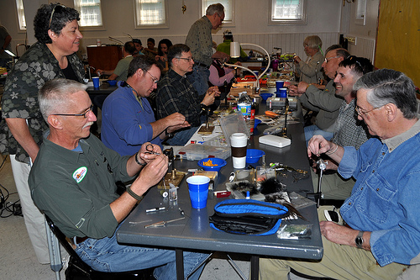
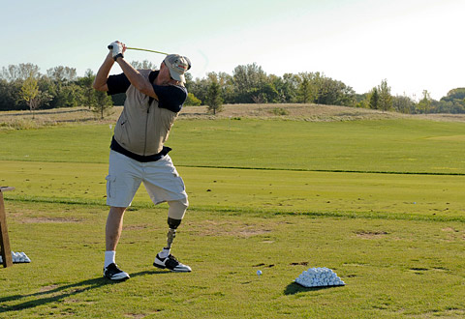
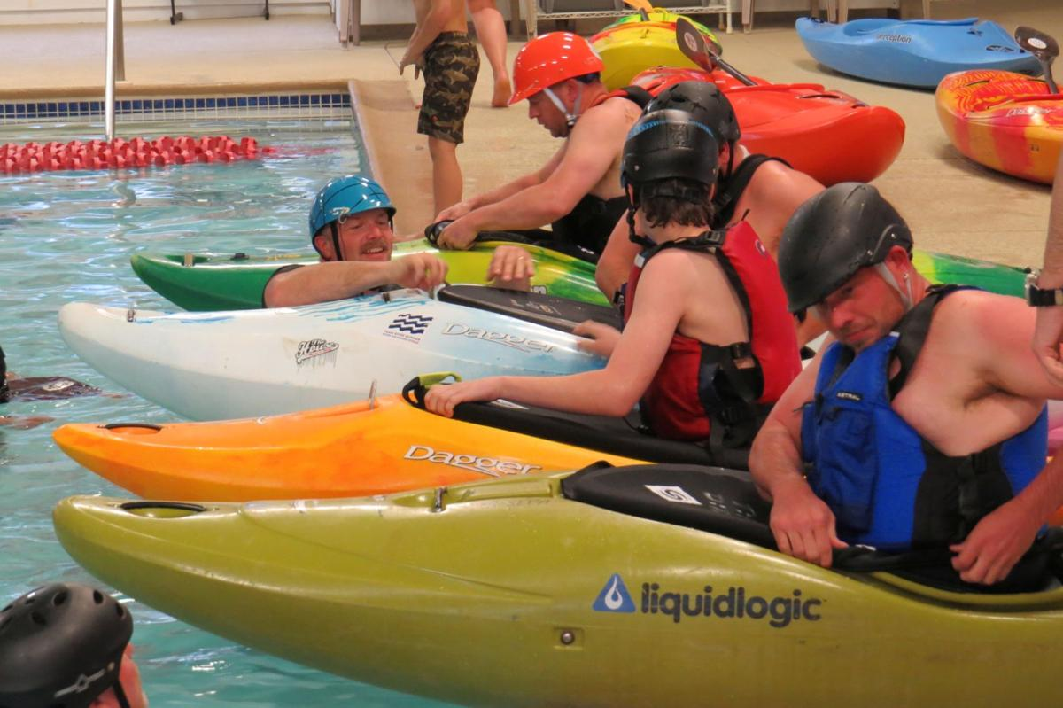
Recreation Therapy (RT)
Notes:
Recreation Therapy is organized 2 very distinct ways: Centralized and Decentralized.
Centralized: RT is headed by a RT department chief whom controls the operations and supervision of all RT’s, programming, allocation of funds, etc. working as its own department at the hospital.
Decentralized: RT is headed by the PMR service chief, RT’s are allocated to units/departments that have specific requirements or needs based on population and service demand. Usually, in a decentralized RT organizational chart, each RT is functionally independent writing and orchestrating their own programming, controlling funds, and setting monthly calendars of events.

Slide 7
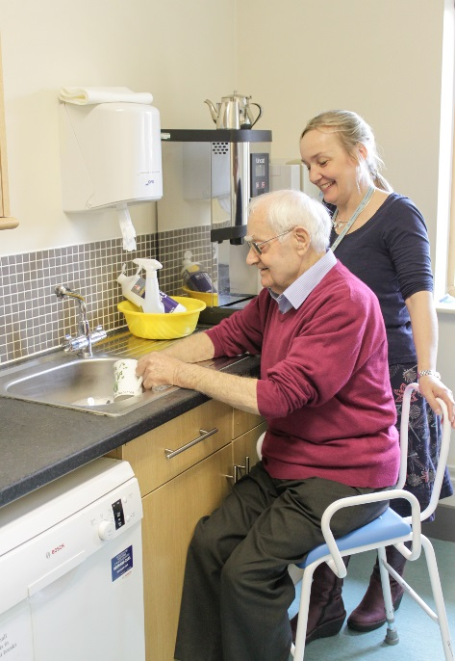
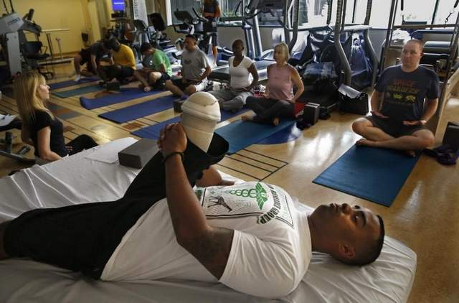
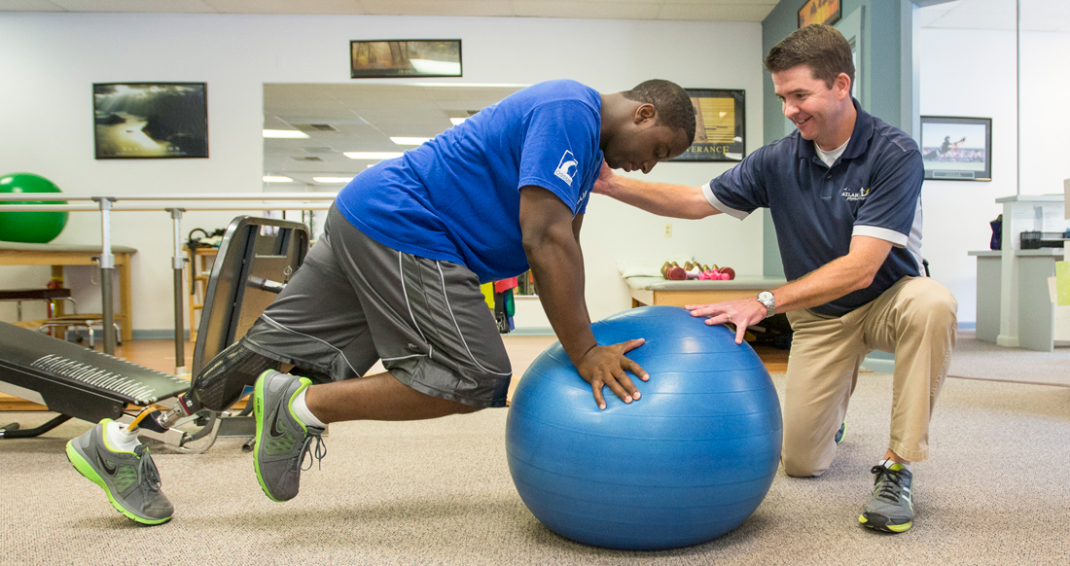
Physical Medicine and Rehabilitation (PMR)
OT: Occupational Therapy
RT: Recreation Therapy
PT:
Physical Therapy
Prosthetics
Notes:
1. Physical Medicine and Rehabilitation is the service line that incorporates Recreation Therapy (RT) into their supervision under a decentralized organizational chart. Units and population demands vary from hospital to hospital, however usually RT’s can be found running programming in a Community Living Center (CLC), inpatient programming for specific needs/diagnosis (Substance Abuse, Post-traumatic Stress), or with a specific target population i.e. Post 9/11 combat Vets, or Home-based Primary Care (HBPC).
2. PMR also houses OT’s, PT’s, & Prosthetics: Many RT’s, PT’s, and OT’s work together on a Veterans treatment plan using a team or multi-disciplinary approach to orchestrate a holistic and patient centered outcome for care.

Slide 8
Voluntary Service (VS)
Notes:
VS is organized like all VHA dept.’s; there is a chief and usually 1-2 VS clerks or administrative personnel.
VS is the “gatekeeper” of all persons whom desire to volunteer in any capacity or role with the VHA.
Hopeful volunteers are required to fill out a volunteer packet which includes a background check. The volunteers must pass a physical, be screened for drugs and alcohol, and undergo a security and background check before being fingerprinted and enrolled into the VHA’s robust volunteer service.
These steps are necessary to ensure the Health Insurance Portability and Accountability Act (HIPAA) of 1996 protocols are followed regarding patient privacy, handling, and safety.

Slide 9
Steps and Procedures to Form Alliance
Call local VA operator and ask to speak with a Recreation Therapist.
If no RT at VA or available, ask to speak to chief or clerk at VS.
Be well prepared and ready to make a case for why you think your program would benefit the Vets, hospital, and community.
RT
Establish presence
Intro self and TU VSP
VS
Determine if no RT’s what possible COA
Intro self and TU VSP
Set meeting and determine alliance viability
Come prepared with offerings, and potential schedule
Set meeting to determine alliance viability
Come prepared with offerings and potential schedule
Notes:
Establish presence: calling the VA operator to ask if there is a Recreation Therapy service department is key. Then you can determine if you have a centralized or decentralized dept. on your hands and what you should do next. If there is not a department, next step is to ask if there is a RT you can speak with that works in a unit. If the operator cannot find one or does not know, ask to speak to someone if physical medicine and rehab. The clerk will be able to direct you to the RT on station.
I cannot imagine a full service VAMC not employing an RT, however, they may have limited roles such as being inpatient, and may not be able to help. If this is determined, go the VS route and establish a line of communication with them.

Slide 10
Come Prepared and Organized
Notes:
The more brochures, fliers, etc. you have ready and aligned with what you are offering to help establish will help your case and determination to succeed in establishing an alliance.
Typically, RT’s have set programming and may find it difficult to find the time to completely orchestrate a new program.
A prepared and thought out plan of action, complete with logistics, intent, schedule, and personnel expectations will make the outcome of your meeting positive.
Showcasing other programs currently operating, success stories, viability and demand will help to increase your chances of establishing an alliance and most importantly diversifying the programs being offered to Vets.

Slide 11
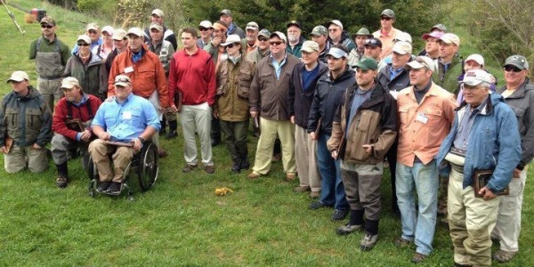
Working in your favor
Notes:
There are dozens of VSP programs already up and running around the country and in numerous VAMC’s. Expanding already existing programs is easier to employ and it will help to have any RT that is currently involved in some capacity as a reference or contact point for a new RT you are seeking to establish presence with.
The VA is only as successful as it’s commitment to the Vets it serves. Promoting opportunities the Vets will have, what they will learn, how it will help their overall health and related quality of life, will go far to ensure your program becomes a reality and success and ultimately help to drive the success and quality of care provided by your local VA.

Slide 12
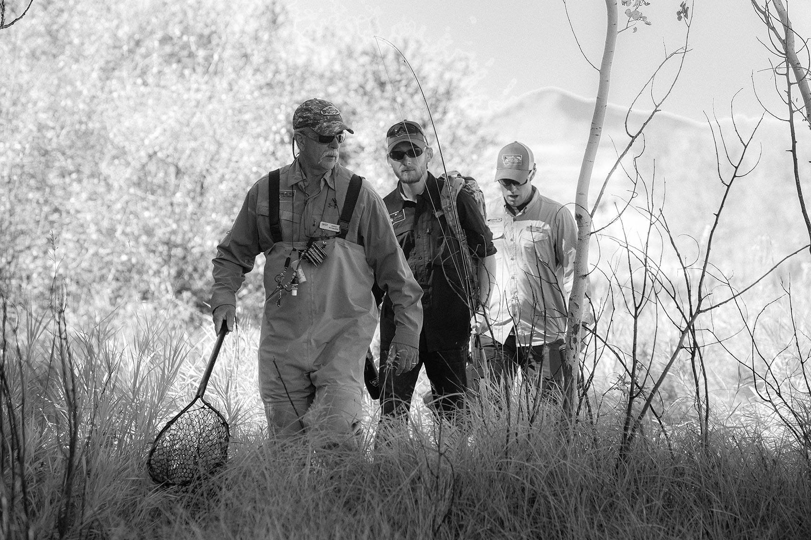
Question’s ?

Slide 13
POC for Help/Troubleshooting VA Navigation:
Dustin Alger M.S., CTRS
Boise, Idaho VAMC
TRC – PTSD & RSAT
(208) 422-1000 x 7511
Jerry Lorang, VA (Ret)
Tualatin TU and Oregon TU VSP Coordinator
(971) 404-5154
jerrylorang@gmail.com

